Slide 1





Install and Configure PHP: XAMPP, LAMP, IDEs
PHP, CGI, Web Server. XAMP / LAMP / PHP in IIS. PHP IDEs
Svetlin Nakov
Technical Trainer
www.nakov.com
Software University
http://softuni.bg

Slide 2

Table of Contents
PHP, Web Servers, HTTP, CGI
XAMPP: Install and Configure
PHP in IIS: Install and Configure
LAMP: Install and Configure
Configuring PHP: php.ini
PHP IDEs: Aptana, PHP Storm, Netbeans

Slide 3



PHP, Web Servers, HTTP, CGI

Slide 4
What is PHP?
PHP is a server-side scripting language
Designed for Web development
Mix HTML with PHP to create dynamic Web pages
Can be used as general purpose language, e.g. for desktop and command-line apps
Free and open-source: http://php.net
Huge popularity: 240 millions sites run PHP in 2013
PHP: Hypertext Preprocessor (a recursive acronym)

Slide 5
PHP – Example
<!DOCTYPE html>
<html>
<body>
<h1>PHP Example</h1>
<?php
for ($i=0; $i<10; $i++) {
echo $i . "<br>\n";
}
?>
</body>
</html>

Slide 6




Web Servers
A Web server is a software application that serves Web content over the HTTP protocol
Hosts Web sites, Web applications and REST services
Processes HTTP requests and returns static / dynamic Web content (HTML, CSS, images, JSON, JS)
Runs server side scripts like PHP, Python and Ruby
Typically a client (Web browser) requests a Web page, the Web server builds the page and returns it

Slide 7

What is HTTP?
Hyper Text Transfer Protocol (HTTP)
Client-server protocol for transferring Web resources
HTML files, CSS styles, images, scripts, JSON data, etc.
Important properties of HTTP
Request-response model
Text-based format
Relies on a unique resource URLs
Stateless (cookies can overcome this)

Slide 8
HTTP – Example
Sample HTTP request:
Sample HTTP response:
The empty line denotes the end of the request header
GET / HTTP/1.1
Host: softuni.bg
User-Agent: Mozilla/5.0
HTTP/1.1 200 OK
Server: Microsoft-IIS/8.5
Date: Thu, 17 Jul 2014 12:11:44 GMT
Content-Length: 8560
<!DOCTYPE html>
…
The empty line denotes the end of the response header

Slide 9
What is CGI?
CGI == Common Gateway Interface
An interface to connect Web servers with server-side scripts
E.g. connect PHP with Apache or Python with IIS
Goal: generate dynamic Web content
Web server passes the HTTP request and produces HTTP response
Many technologies to connect Web servers with server scripts:
CGI, FastCGI, Apache modules, ISAPI (IIS), WSGI, Ruby Rack, …
E.g. mod_php, mod_python, mod_wsgi, …

Slide 10
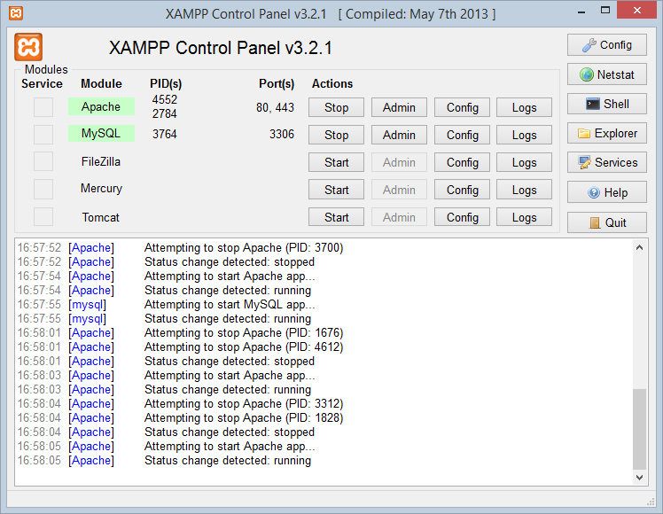

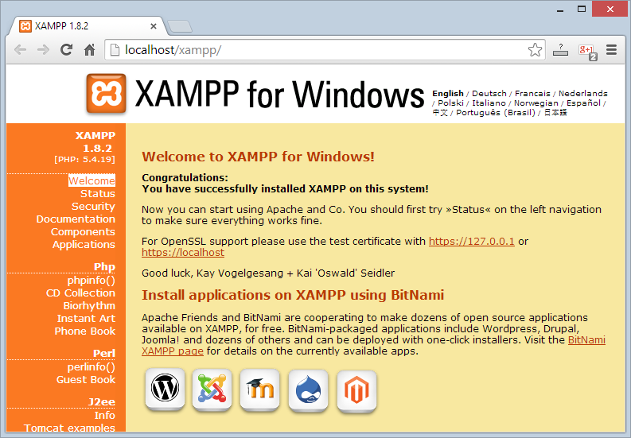
XAMPP
Install and Configure XAMPP

Slide 11
What is XAMPP?
XAMPP (/ˈzæmp/ or /ˈɛks.æmp/)
Free, open source cross-platform Web server solution stack
Runs in Windows, Linux and Mac OS X
Apache Web server + OpenSSL
MySQL database + phpMyAdmin
Scripting languages: PHP and Perl
FileZilla FTP server
Mercury mail server (SMTP and POP3)
Provides an admin panel for simplified administration

Slide 12
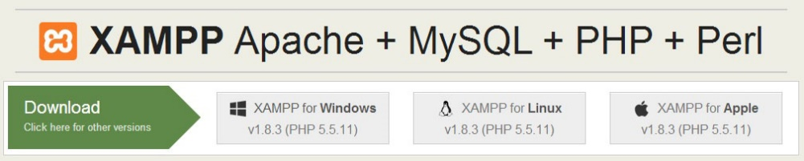
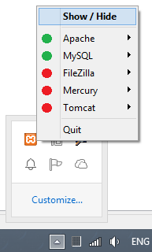
Download, Install and Run XAMPP
Downloading XAMPP:
https://www.apachefriends.org/download.html
Installing XAMPP for Windows:
Download the installer (run it as administrator)
Usual Windows installation: Next -> Next -> Finish
Running XAMPP
XAMPP start as a tray icon

Slide 13
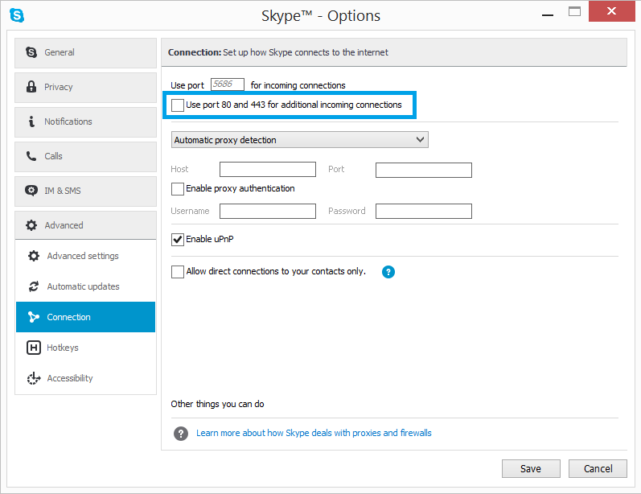
XAMPP: Collision with Skype

Slide 14
Changing the Apache HTTP Port
You may have IIS or other Web server running on your machine
This will take the standard HTTP and HTTPS ports: 80 and 443
You may change the Apache HTTP listening port
From XAMPP Control Panel choose Apache -> Config
This will open .\apache\conf\httpd.conf
Search for “Listen 80”
Replace with “Listen 8080” (for example)
Access XAMPP from http://localhost:8080

Slide 15
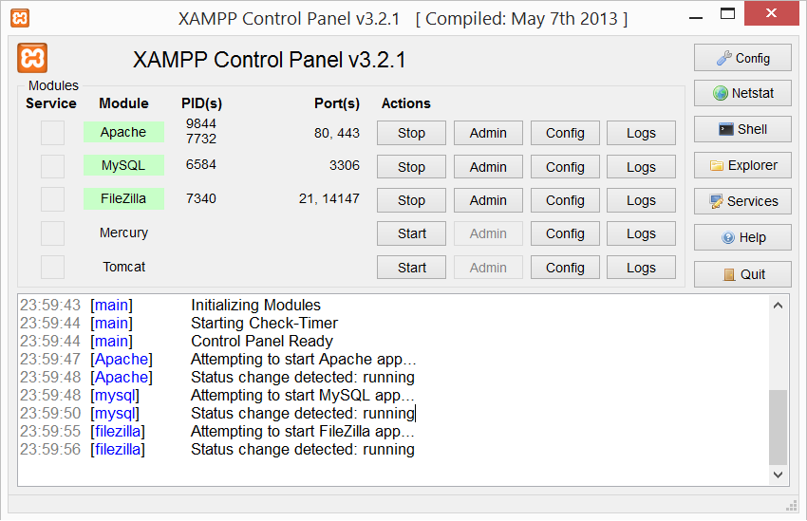
XAMPP Control Panel
Used TCP ports
Windows process IDs
System messages (logs)

Slide 16
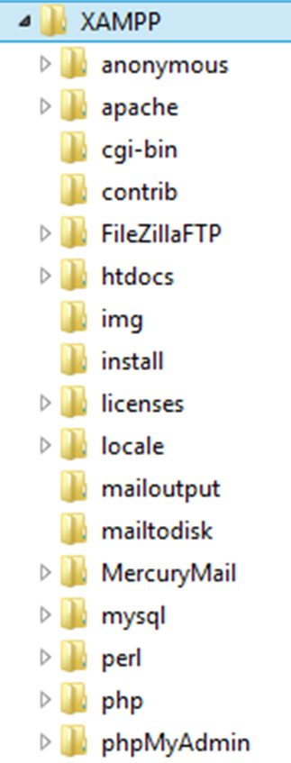
XAMPP Directories
Location of public HTML files (document root)
./htdocs
Location of Apache web server
./apache
Location of PHP
./php
Location of MySQL database
./mysql

Slide 17
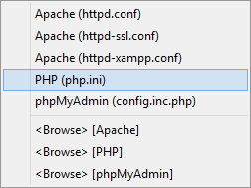

XAMPP Configuration Files
Apache configuration file (httpd.conf)
.\apache\conf\httpd.conf
PHP configuration file (php.ini):
.\apache\bin\php.ini
MySQL configuration file (my.cnf):
.\mysql\bin\my.cnf

Slide 18
XAMPP
Live Demo

Slide 19

PHP in IIS
Running PHP in Microsoft Internet Information Services (IIS)

Slide 20
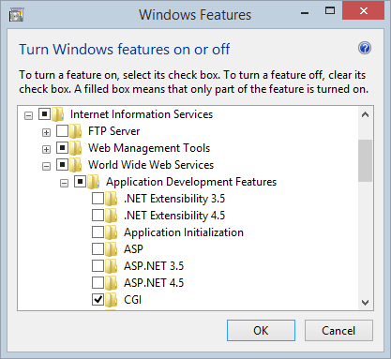

PHP in IIS
Installing IIS:
Turn Windows features on or off → Internet Information Services
Install HTTP Features, CGI and IIS Management Console
Integrating PHP in IIS:
Install PHP Manager for IIS from http://phpmanager.codeplex.com
Register new PHP version

Slide 21
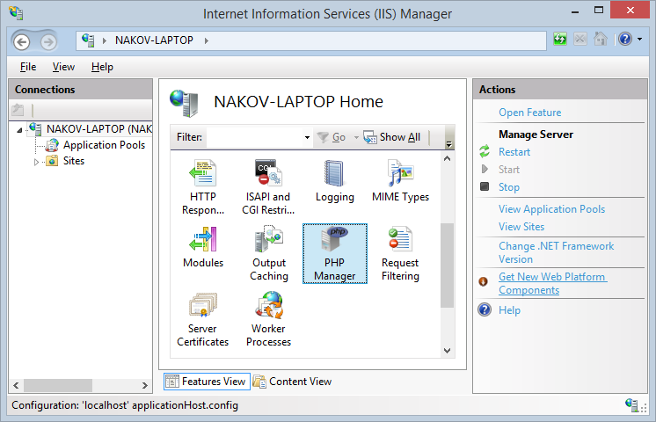
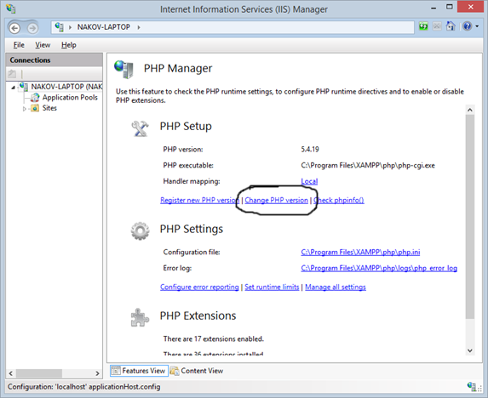
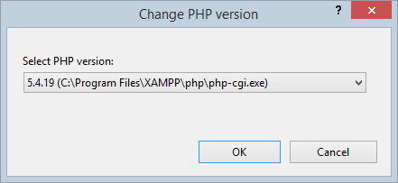
PHP in IIS (2)

Slide 22

LAMP
Linux, Apache, MySQL, PHP

Slide 23
What is LAMP?
LAMP stands for Linux, Apache, MySQL, PHP
An open source Web development platform
Linux – server operating system
Apache – Web server
MySQL – relational database management system
PHP – object-oriented server-side scripting language
LAMP is an application development platform
Not just a software bundle

Slide 24
Download and Install on Ubutntu
Open terminal, then just type:
Apache document root: /var/www/html
Start / stop Apache service (in Ubuntu)
Create a PHP script /var/www/html/index.php
Test it by opening http://localhost/index.php
sudo apt-get install lamp-server^
sudo service apache2 start | stop | restart

Slide 25

PHP Settings
The php.ini File

Slide 26
PHP Settings
PHP settings (called directives) are stored in the php.ini file
A set of name = value statements
If there is no value, the directive is left as name =
Comments start with a semicolon ;
The location of the file is different across operating systems and versions
You can check which php.ini file is loaded with phpinfo()
PHP supports add-ons
Most add-ons read their settings from the same file

Slide 27
Language Settings
Directive | Default | Description
short_open_tag | Off | Whether <? and ?> tags should be allowed
asp_tags | Off | Whether <% and %> tags should be allowed
precision | 14 | The number of significant digits displayed in floating-point numbers
expose_php | On | Include X-Powered-By: PHP/<version> HTTP header in responses
disable_functions | “” | A comma-separated list of which functions should not be available at runtime
disable_classes | “” | A comma-separated list of which classes should not be available at runtime

Slide 28
Data Handling Settings
Directive | Default | Description
track_vars | “On” | Whether or not the EGPCS ($_ENV, $_GET, $_POST, $_COOKIE, $_SERVER) arrays will be available
register_globals (Removed in PHP 5.4.0) | Off | Whether or not to register the EGPCS arrays as global variables (e. g. $_GET[“name”] will become $name)
variables_order | “EGPCS” | The order in which to register the global EGPCS arrays (“GP” means that only $_GET and $_POST will be available)
post_max_size | “8M” | The maximum size of post data allowed
default_mimetype | “text/html” | The default MIME type of the HTTP response
default_charset | “UTF-8” | The default charset of the HTTP response

Slide 29
File Upload Settings
Directive | Default | Description
file_uploads | “On” | Whether or not to allow file uploads
upload_tmp_dir | NULL | The temporary directory to store files at the server during upload
upload_max_filesize | “2M” | The maximum size of an uploaded file
max_file_uploads | 20 | The maximum number of files allowed to be uploaded at the same time

Slide 30
Paths and Directories
Directive | Default | Description
include_path | “.;path/to/php/pear” | The path where functions like include() and require() look for files
open_basedir | NULL | The only base directory (and all its subdirectories) which are accessible to PHP
doc_root | NULL | PHP’s “root directory” on the server
user_dir | NULL | The user’s home directory for PHP files
extension_dir | “path/to/php” | The path where PHP should look for dynamically loadable extensions

Slide 31
Other Settings
Directive | Default | Description
output_buffering | “4M” | How much output should be kept before pushing it to the client (“On” for unlimited buffer side, integer value for buffer size)
implicit_flush | Off | Whether or not to flush the output buffer after each block
max_execution_time | 120 | Maximum execution time of a script in seconds
memory_limit | “128M” | Maximum memory (in bytes) that a script is allowed to allocate (-1 for no memory limit)

Slide 32
Changing Settings at Runtime
Get the runtime value of a php.ini variable:
Get the value of a php.ini variable which is stored in the file:
Change the value of a php.ini variable at runtime:
See the current values of the PHP settings:
ini_get(“upload_max_filesize”);
get_cfg_var(“upload_max_filesize”);
ini_set(“include_path”, “c:/php/PEAR”);
phpinfo();

Slide 33

Apache Settings
The httpd.conf file

Slide 34
Apache Settings
Apache settings are defined in the httpd.conf file
Location and name may differ across platforms and Apache versions
Older version read from multiple files
The site-specific settings and module-specific settings are in separate files
Follows a syntax close to XML
Name-value pairs sometimes in tags

Slide 35
Connection Settings
Directive | Default | Description
TimeOut | 300 | The number of seconds before the server sends timeout to a dead connection
KeepAlive | On | Turns persistent connection on or off
MaxKeepAliveRequests | 100 | The maximum number of persistent connections allowed at the same time
KeepAliveTimeout | 5 | The number of seconds before closing a dead persistent connection

Slide 36
Log Settings
Directive | Default | Description
ErrorLog | logs/error_log (Linux) / logs/error.log(Windows) | Sets the Apache log file; can be specified separately for each site
LogLevel | warn | Sets the level of logging; possible values – debug, error, info, notice, warn, error, crit, alert, emerg
LogFormat | "%h %l %u %t \"%r\" %>s %b" | Specifies nicknames for different log formats; can be used for site-specific access logs

Slide 37
Other Settings
Directive | Default | Description
Listen | 80 | Sets the port to listen for connections; can be repeated with different ports; usually specified in ports.conf file
HostnameLookups | Off | If turned on, logs the host names of remote clients instead of IP addresses
User / Group | #-1 | Sets the user and group that the Apache process should work in
DirectoryIndex | index.html | Sets the default files in a directory (shown when the user requests the directory)

Slide 38



PHP IDEs
Aptana, PHP Storm, Netbeans

Slide 39
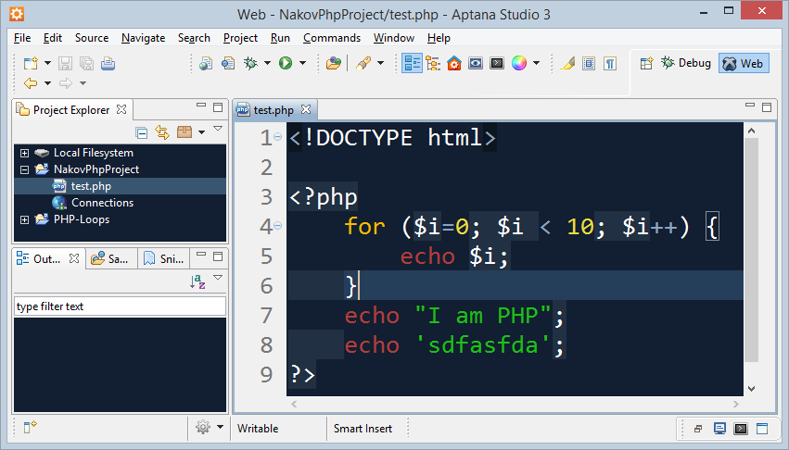
Eclipse / Aptana
The Eclipse platform provides solid PHP development support
PDT – PHP Development Tools
Write PHP code, Web server integration, debugging (XDebug)
Free, open-source: http://www.eclipse.org/pdt/
Aptana Studio
Eclipse-based IDE for PHP, Ruby, Python
Supports also HTML, CSS, JavaScript
Open-source: http://www.aptana.com

Slide 40
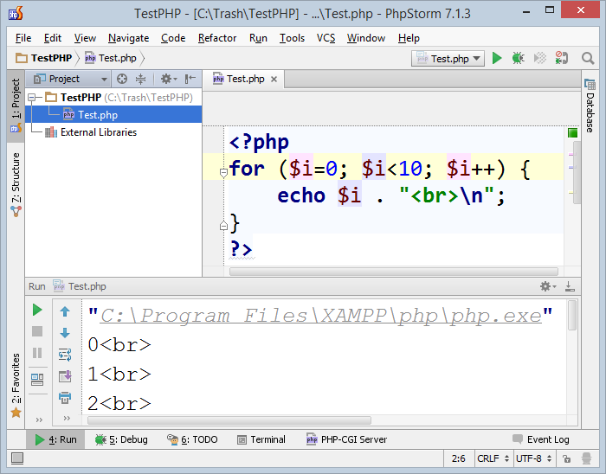
PHP Storm
PHP Storm
Powerful PHP IDE
By JetBrains, paid product
Built-in Web server for simplified configuration
Easy to install and configure
http://jetbrains.com/phpstorm/

Slide 41
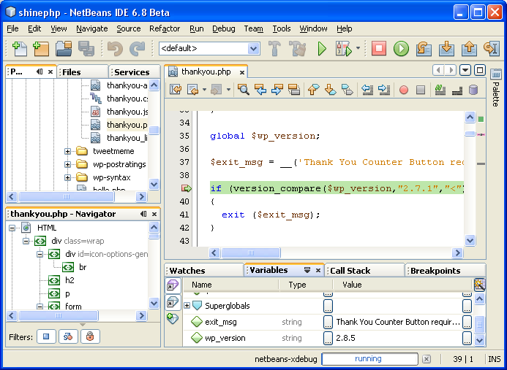
NetBeans for PHP
The NetBeans IDE fully supports PHP
Free, open-source IDE
PHP code editor
Debugger (through XDebug)
Server integration
Frameworks support:
Symfony2, Zend

Slide 42


Summary
PHP == server-side Web scripting language
Web Servers serve web content through HTTP
Run PHP through CGI / mod_php / ISAPI
XAMPP == Apache + PHP + MySQL + Perl
Recommended for Windows users
LAMP == Linux + Apache + MySQL + PHP
php.ini holds the PHP interpreter settings
PHP IDEs: Aptana, PHP Storm, Netbeans
PHP Basics

Slide 43
Install and Configure PHP: XAMPP, LAMP, IDEs
https://softuni.bg/trainings/coursesinstances/details/5

Slide 44
License
This course (slides, examples, demos, videos, homework, etc.) is licensed under the "Creative Commons Attribution-NonCommercial-ShareAlike 4.0 International" license

Slide 45




Free Trainings @ Software University
Software University Foundation – softuni.org
Software University – High-Quality Education, Profession and Job for Software Developers
softuni.bg
Software University @ Facebook
facebook.com/SoftwareUniversity
Software University @ YouTube
youtube.com/SoftwareUniversity
Software University Forums – forum.softuni.bg

